Slide 1

IMPLEMENTATION
OF HOLOCHAIN
THINK OUTSIDE THE BLOCKS

Slide 2

Presented By:
Group - 09
Roll
Name
1972 - Nadia Sultana
1973 - Sidratul Afrida
1977 - Pinky Akhter
1989 - Tasnia Jahan
1991 - Jannatun Akhter Sheli
1993 - Jannatul Ferdous Muna
2089 - Praya Khisa

Slide 3

INTRODUCTION
Holochain is a distributed peer-to-peer
application platform that allows developers to
build decentralized applications.
Holochain uses a validation approach based on a
shared set of rules agreed upon by the
participants in the network.

Slide 4
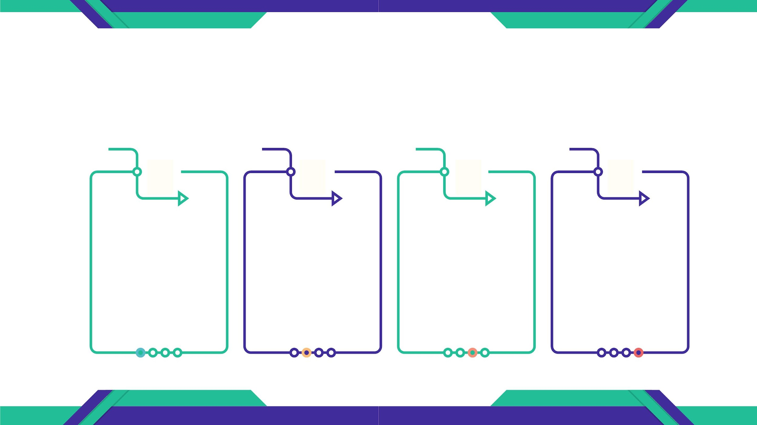
HOLOCHAIN FEATURES
Holochain's features make it a powerful and versatile platform for building
decentralized applications that are scalable, flexible, secure, and efficient.
Scalability
Flexibility
Lightweight
Decentralized
It is highly scalable,
allows large numbers
of transactions
without the
performance issues
It is more flexible,
allows developers to
create custom
It can run on low-
powered devices such
as smartphones and
IoT devices.
It does not rely on a
central authority to
control the network.
application logic and
data structures that
suit their specific needs.

Slide 5
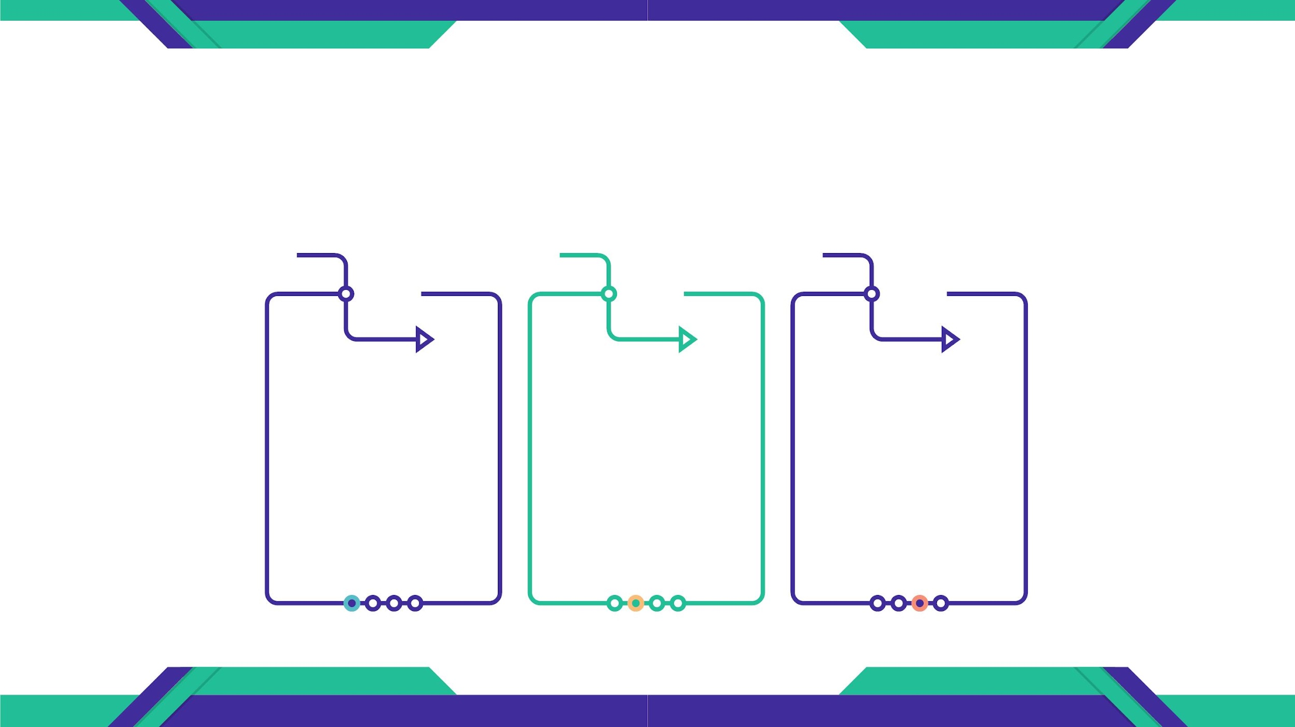
HOLOCHAIN FEATURES
Holochain's features make it a powerful and versatile platform for building
decentralized applications that are scalable, flexible, secure, and efficient.
Security
Privacy
Sustainability
It provides a high level
of security through
cryptographic
mechanisms that
protect the integrity and
confidentiality of data
There is no central
database that can be
hacked or exploited, so
privacy is maintained.
It is sustainable
because, it uses less
energy and
computing resources
to operate

Slide 6
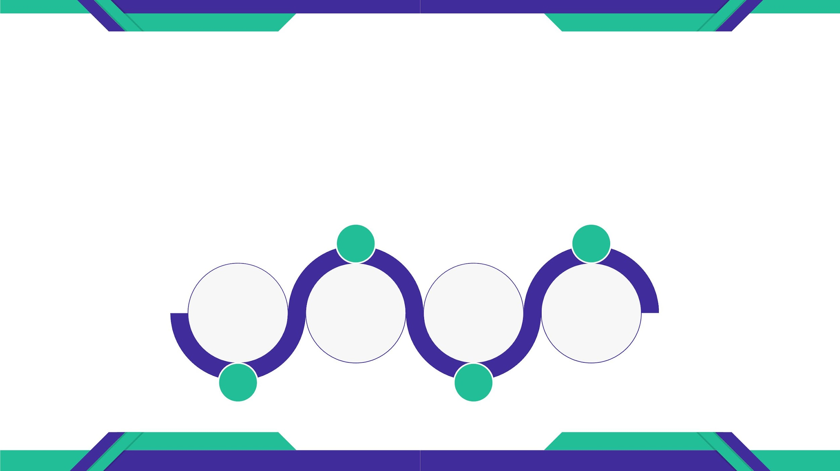
HOW HOLOCHAIN WORKS?
Holochain works by providing a way for individual nodes to run a copy of
the dApp and communicate directly with each other.
Application DNA defines the data
structures, validation rules, and
interaction patterns of the dApp.
Validated data is hashed & stored
locally on the node's device, making it
easy to identify and retrieve the data.
Application
DNA Creation
Distributed
Hash Table
Storage
Local
Validation
Hashing and
Persistence
Each node in the network runs a
copy of the application DNA and
validates the data it receives from
other nodes.
Each node maintains a DHT that
stores metadata about the data
stored on other nodes in the network.

Slide 7
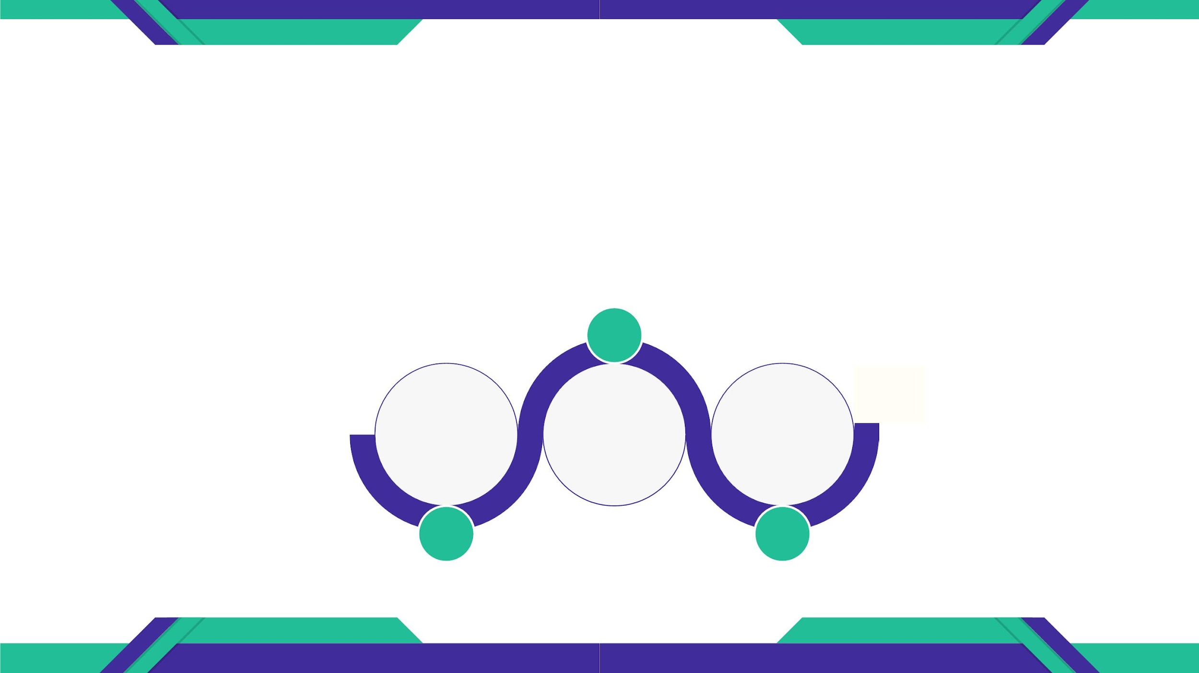
HOW HOLOCHAIN WORKS?
Holochain works by providing a way for individual nodes to run a copy of
the dApp and communicate directly with each other.
Agent-centric communication mode allows
nodes to communicate directly with each
other without intermediaries.
Each dApp can define its own
consensus algorithm and rules for
data agreement..
Agent-
Centric
Gossip
Protocol
Consensus
Communication
In this protocol, nodes exchange
validated data with other nodes in
the network, propagating the data to
all nodes.

Slide 8
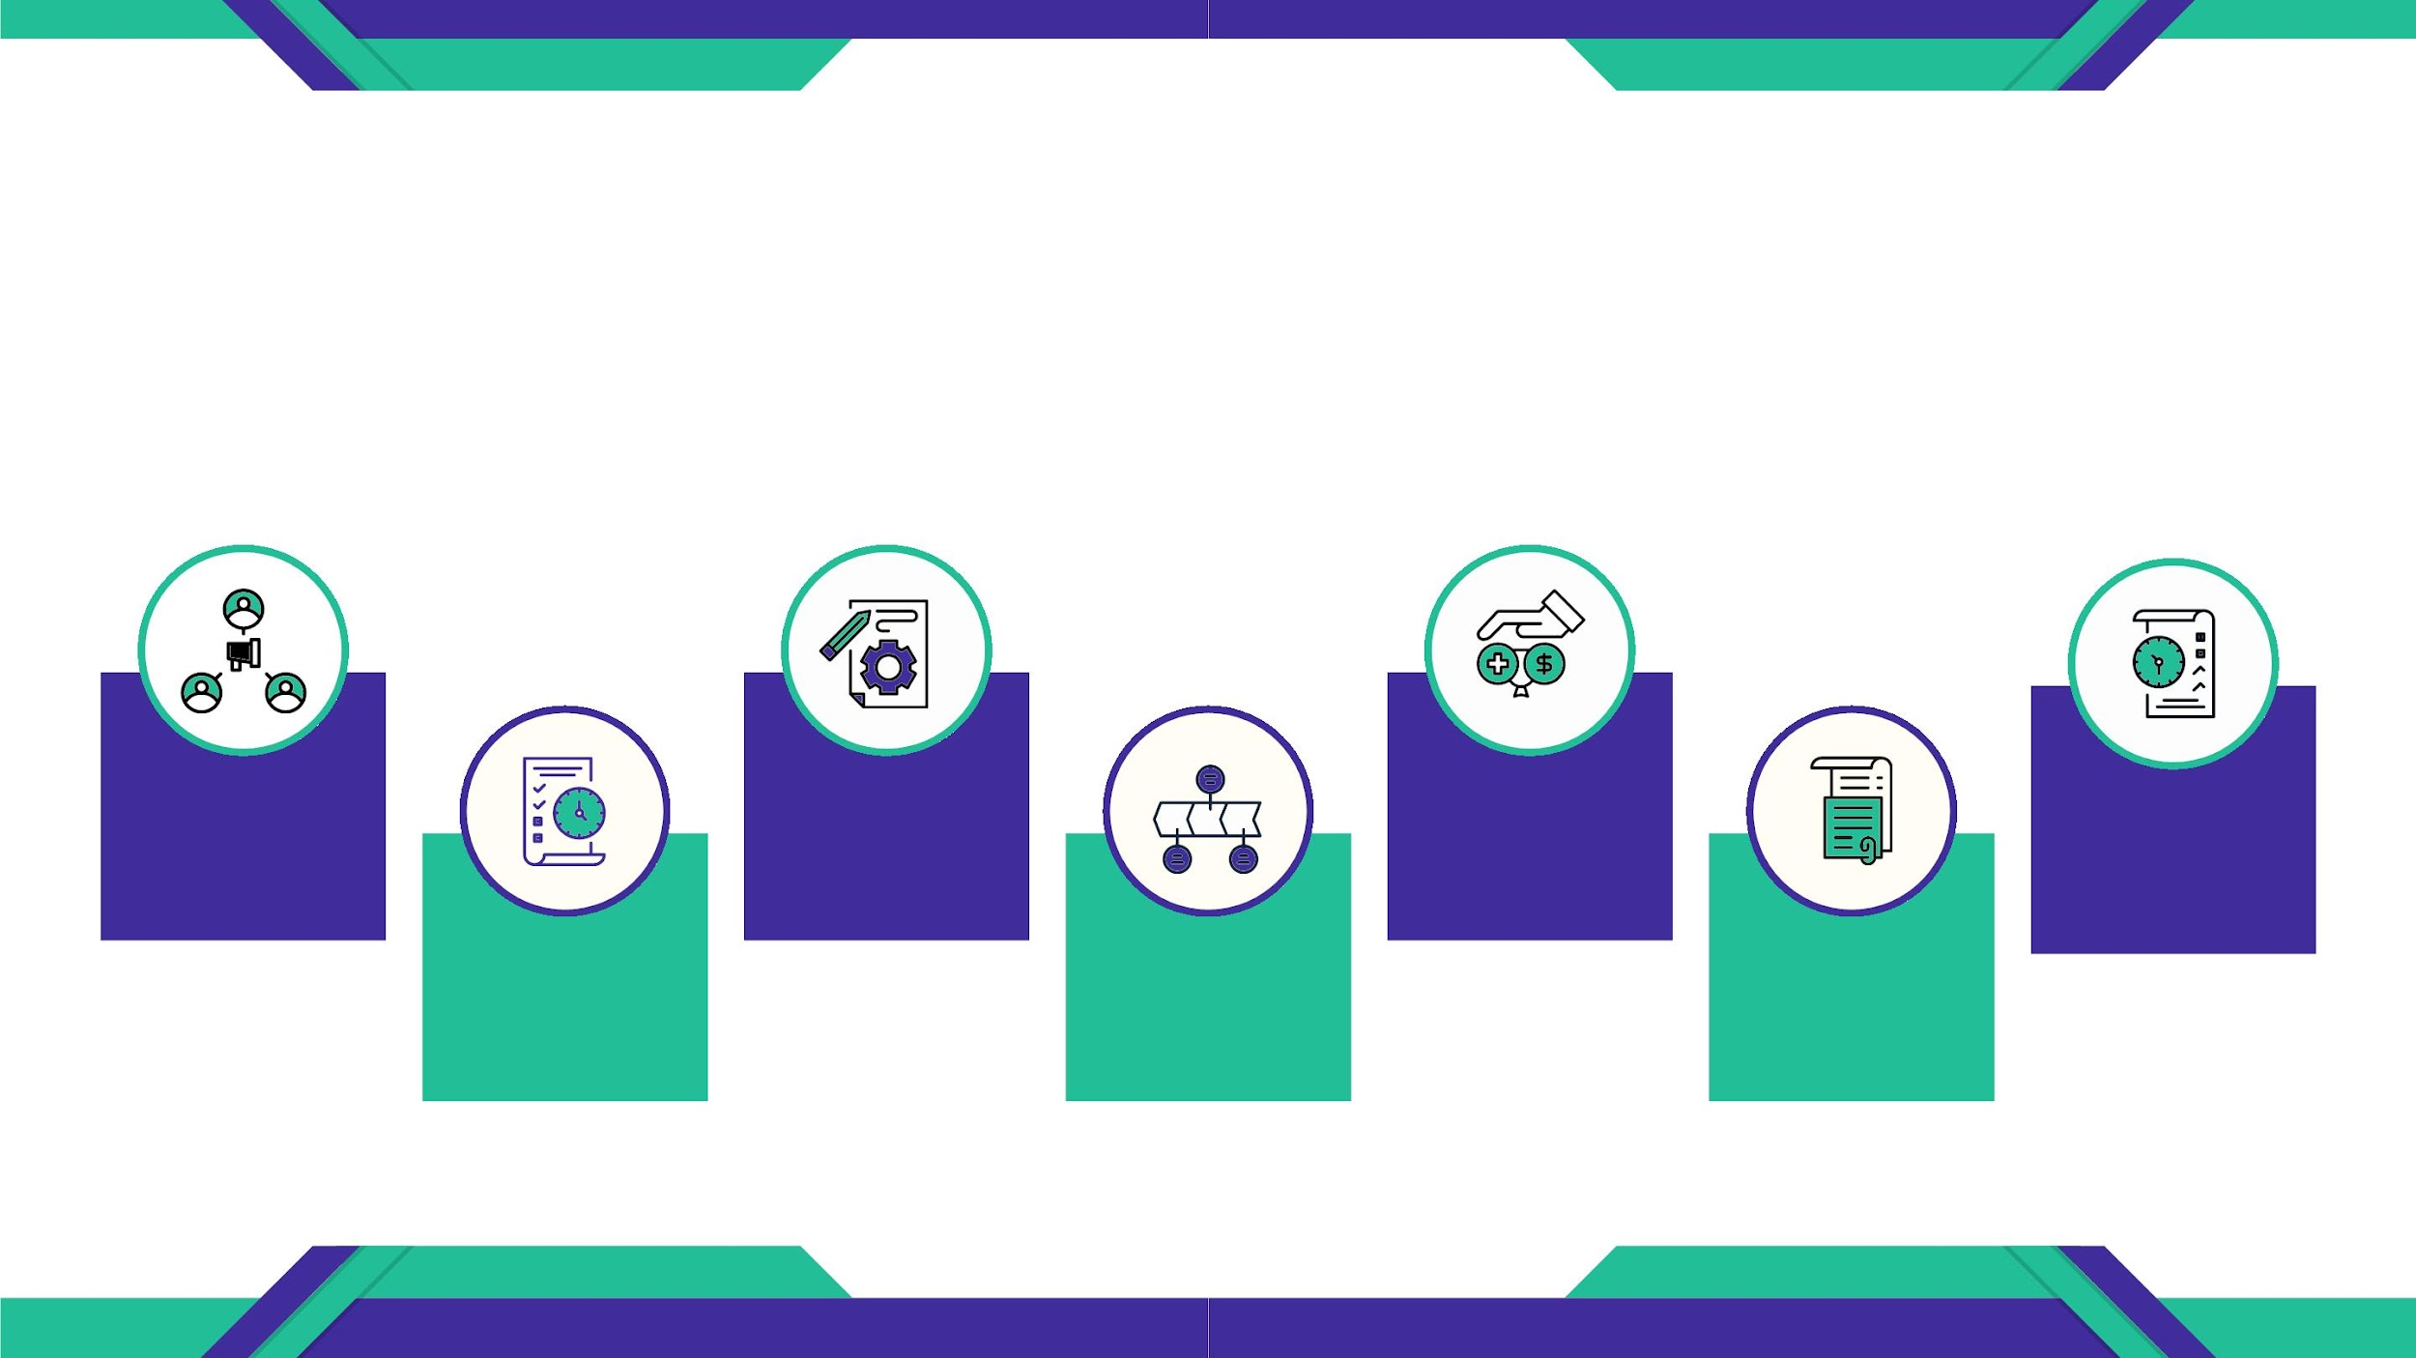
HOW CAN HOLOCHAIN BE USED?
Holochain can be used to create different kind of apps
Social Media
apps
Supply chain
Collaborative
apps
oriented
apps
Reputation
Systems
Platform-
related
apps
Relationship
managment
apps
Resource
Management
apps

Slide 9
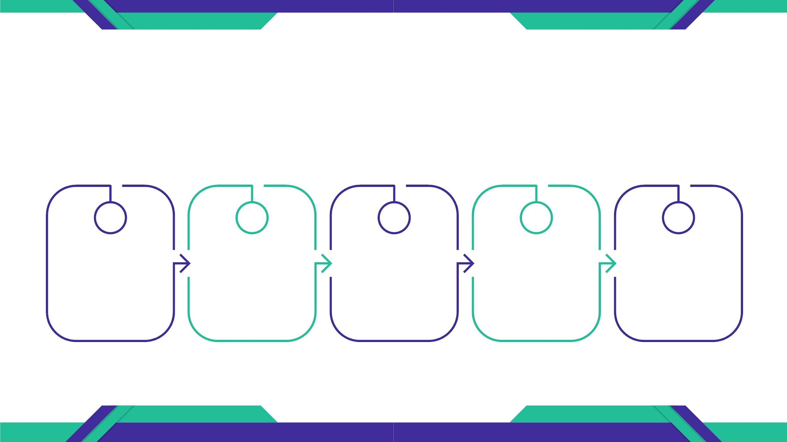
IMPLEMENTATION OF HOLOCHAIN
The implementation of Holochain involves significant steps. It requires
knowledge of distributed computing, programming, and cryptography.
Defining the
application
requirements
Developing
the
application
code
Testing and
debugging
Deployment
Maintenance
and updates

Slide 10

IMPLEMENTATION OF HOLOCHAIN
1. DEFINING THE APPLICATION REQUIREMENTS
Identify the specific use case and
functionality that the decentralized App
needs to perform.
This includes designing the data
structures, defining the validation rules,
and specifying the interaction patterns
between users.

Slide 11

IMPLEMENTATION OF HOLOCHAIN
2. CREATE THE APPLICATION DNA
The Holochain application DNA
(Distributed Network Application) is a set
of code and configuration files that
define the behavior of the application.
It includes the validation rules, data
schemas, and entry types.

Slide 12

IMPLEMENTATION OF HOLOCHAIN
3. BUILD THE UI
The user interface of the decentralized App
can be created using any web development
framework.
The UI communicates with the Holochain
backend using a library called Holochain-
Redux.

Slide 13
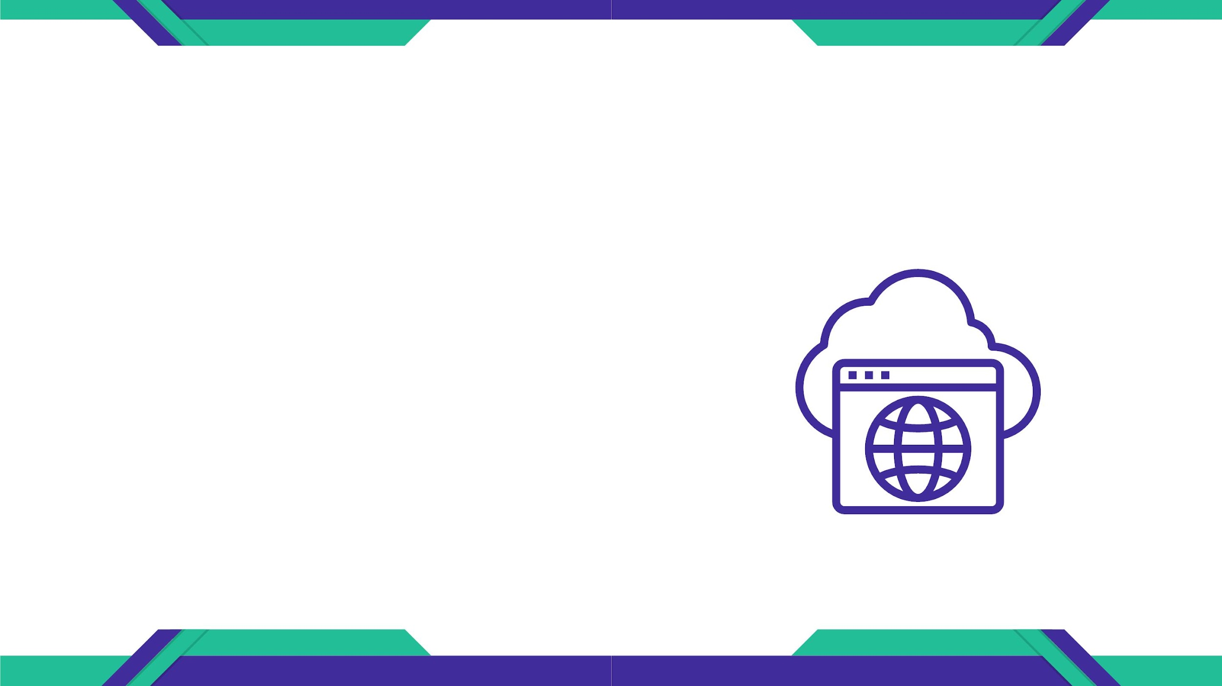
IMPLEMENTATION OF HOLOCHAIN
4. DEVELOP THE CONDUCTORS
Conductors are the local instances of the
Holochain nodes that are responsible for
hosting and executing the application DNA.
The Holochain development kit provides
tools to create and manage conductors.

Slide 14

IMPLEMENTATION OF HOLOCHAIN
5. TEST THE APPLICATION
Test the application DNA and the UI by
running the conductors and
simulating different scenarios.
This will help to identify and resolve
any bugs or issues in the code.

Slide 15
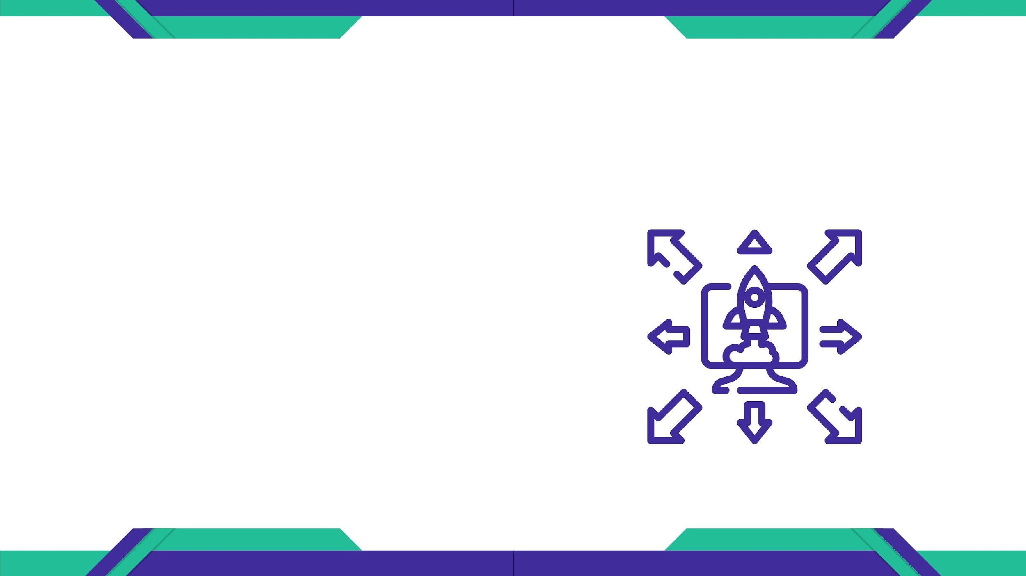
IMPLEMENTATION OF HOLOCHAIN
6. DEPLOY THE APPLICATION
Once the application is fully tested, it
can be deployed to the Holochain
network.
The Holochain network is a collection of
nodes that run the Holochain software
and host different dApps.

Slide 16
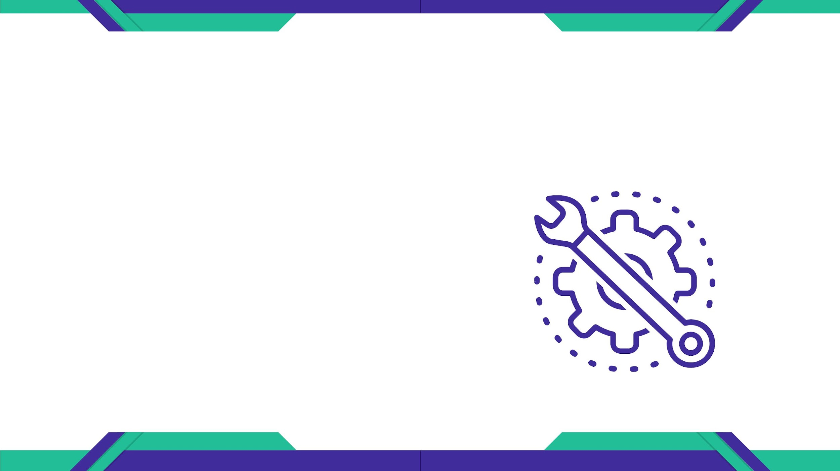
IMPLEMENTATION OF HOLOCHAIN
7. MAINTAIN THE APPLICATION
Once the application is deployed, it will
need to be maintained and updated over
time.
Holochain provides tools for monitoring
the performance of the application and
fixing any issues that may arise.

Slide 17
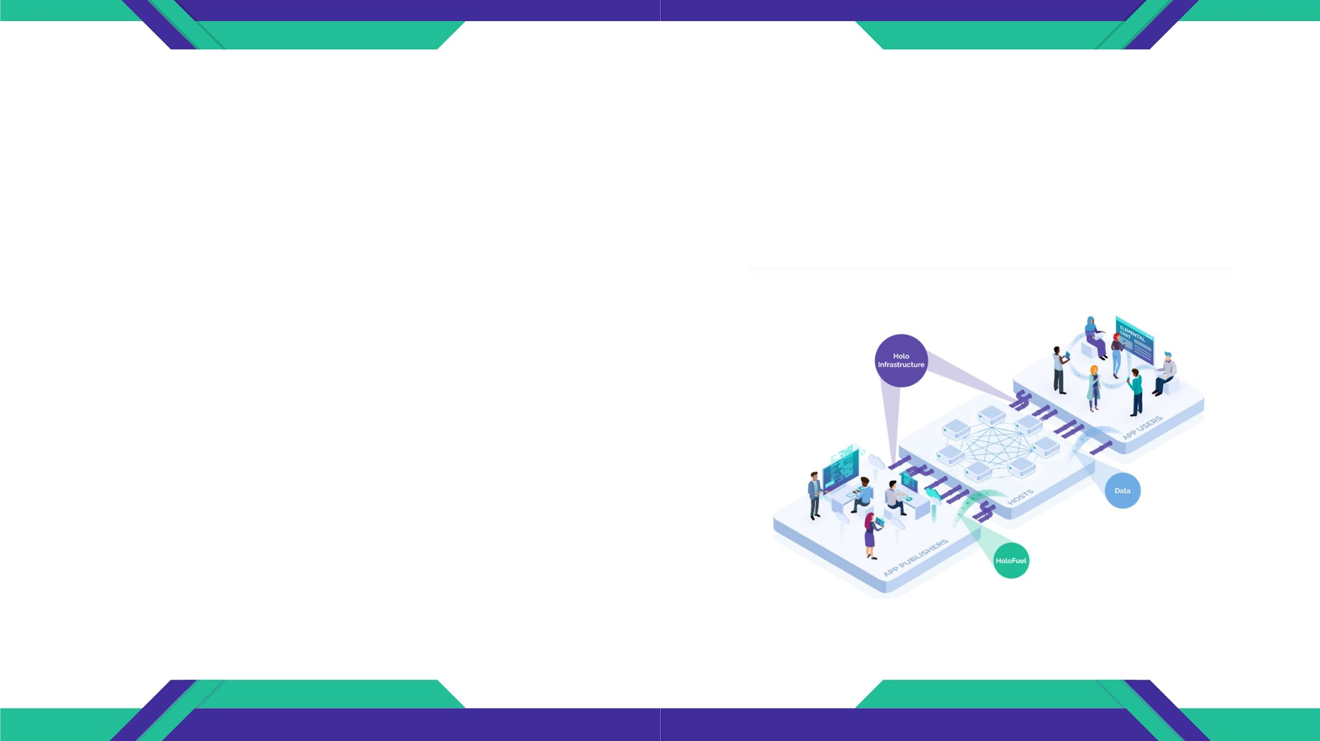
EXAMPLE OF HOLOCHAIN IMPLEMENTATIONS
HOLO PLATFORM
The Holo infrastructure supports three main
players.
App Publishers pay Hosts in HoloFuel to rent
their extra data storage and compute power.
App Users are served distributed apps from the
Hosts.

Slide 18

EXAMPLE OF HOLOCHAIN IMPLEMENTATIONS
ELEMENTAL CHAT
Elemental Chat is a secure and private
messaging app that runs on the Holo platform.
It uses Holochain's distributed computing
capabilities to provide a more resilient and
secure messaging system, as there is no central
server that can be hacked or compromised.

Slide 19

EXAMPLE OF HOLOCHAIN IMPLEMENTATIONS
JUNTO
Junto is a social media platform built on
Holochain.
It aims to provide users with greater control over
their data and privacy, while also fostering more
meaningful and authentic interactions between
users.

Slide 20
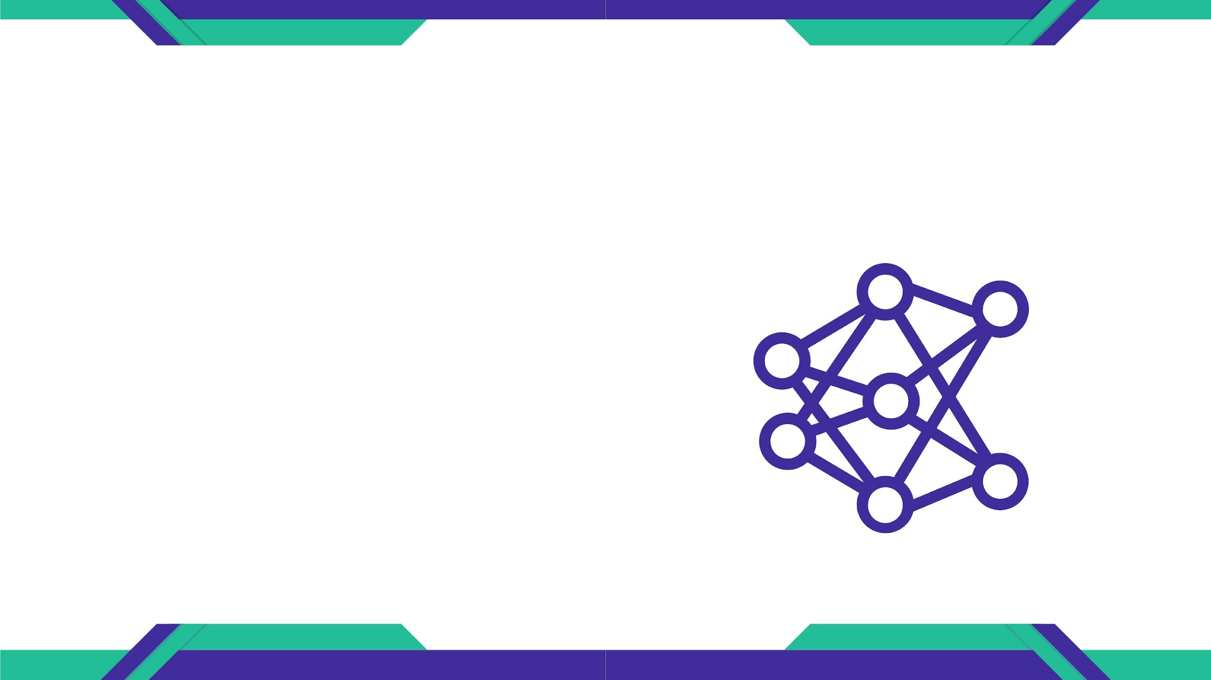
EXAMPLE OF HOLOCHAIN IMPLEMENTATIONS
HYLO
Hylo is a community building platform that
uses Holochain to provide a more decentralized
and resilient network for community building.
It allows users to create and join
communities, organize events, and share
resources and knowledge.

Slide 21

EXAMPLE OF HOLOCHAIN IMPLEMENTATIONS
METACURRENCY
Metacurrency is a project that aims to build a
more equitable and sustainable economic
system using Holochain.
It provides a framework for building decentralized
applications and platforms that can support new
economic models, such as gift economies and
mutual credit systems

Slide 22

EXAMPLE OF HOLOCHAIN IMPLEMENTATIONS
OWNCLOUD
OwnCloud is a cloud storage platform that
uses Holochain to provide a decentralized
alternative to centralized cloud storage
providers.
It allows users to store and share files
securely, without relying on third-party
providers that may be vulnerable to security
breaches or data leaks.

Slide 23
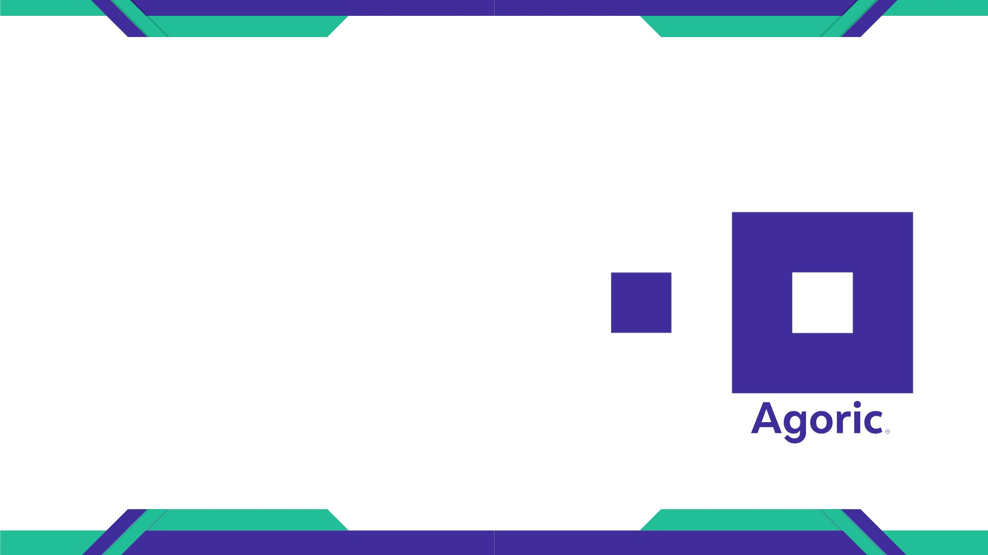
EXAMPLE OF HOLOCHAIN IMPLEMENTATIONS
AGORIC
Agoric is a project that uses Holochain to build a
more secure and scalable smart contract
platform.
It provides a framework for building and
executing smart contracts in a more
distributed and resilient network, without
relying on a central authority or a single point of
failure

Slide 24

THANK YOU

